Slide 1
Footwear Store Sales Analysis Dashboard
Powered by Power BI
Presented by: Yash Tayal, MIS Executive – Dewan Polycaps Pvt. Ltd.

Slide 2
Objective
To analyze footwear sales across regions, products, and retailers.
Provide insights into performance, trends, and profit metrics.
Enable decision-makers to track KPIs and make informed decisions.

Slide 3
Data Overview
Data Sources Used: Retail Sales data (Excel or Power BI)
Dimensions: Product, Region, Retailer, Sales Method, Time
Time Period Covered: 2020–2021
Total Transactions: 9,648
Total Sales: $899.90M

Slide 4
Dashboard Overview
KPIs at the top (Sales, Profit, Margin, Units Sold)
Filters: Year, Quarter, Region, Product
Interactive visual charts for trends and performance

Slide 5
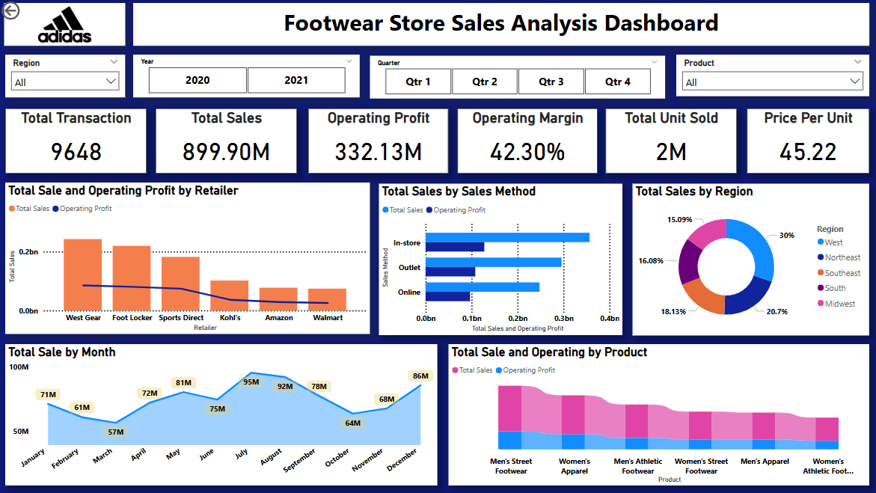

Slide 6
Key Insights
Highest sales from West Gear and Foot Locker
Q3 and Q4 have highest monthly sales (especially July & December)
In-store sales outperform Online and Outlet
West Region leads with 30% of total sales
Men’s Street Footwear is the top-performing product

Slide 7
Dashboard Features
Slicers: Region, Year, Quarter, Product
KPI Cards: Auto-update with filters
Visuals Used:
- Bar Charts for Retailer and Product
- Line & Area Chart for Monthly Trends
- Pie Chart for Regional Sales Share
- Combo Chart for Profit & Sales by Sales Method

Slide 8
Benefits & Impact
Interactive Analysis for leadership and sales team
Improved decision-making using real-time sales insights
Automated reporting, no manual Excel work
Clear visibility of trends, regional strengths, and product performance

Slide 9
Thank You
I’m happy to answer any questions.
– Yash Tayal

